Slide 1
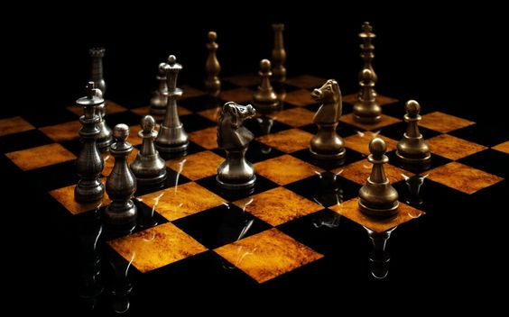
CHESS GAME
Praveenkumar B P [PES2UG22CS414]
Prajwal M Joshi [PES2UG22CS395]
Prarthan M Bevoor [PES2UG22CS408]

Slide 2
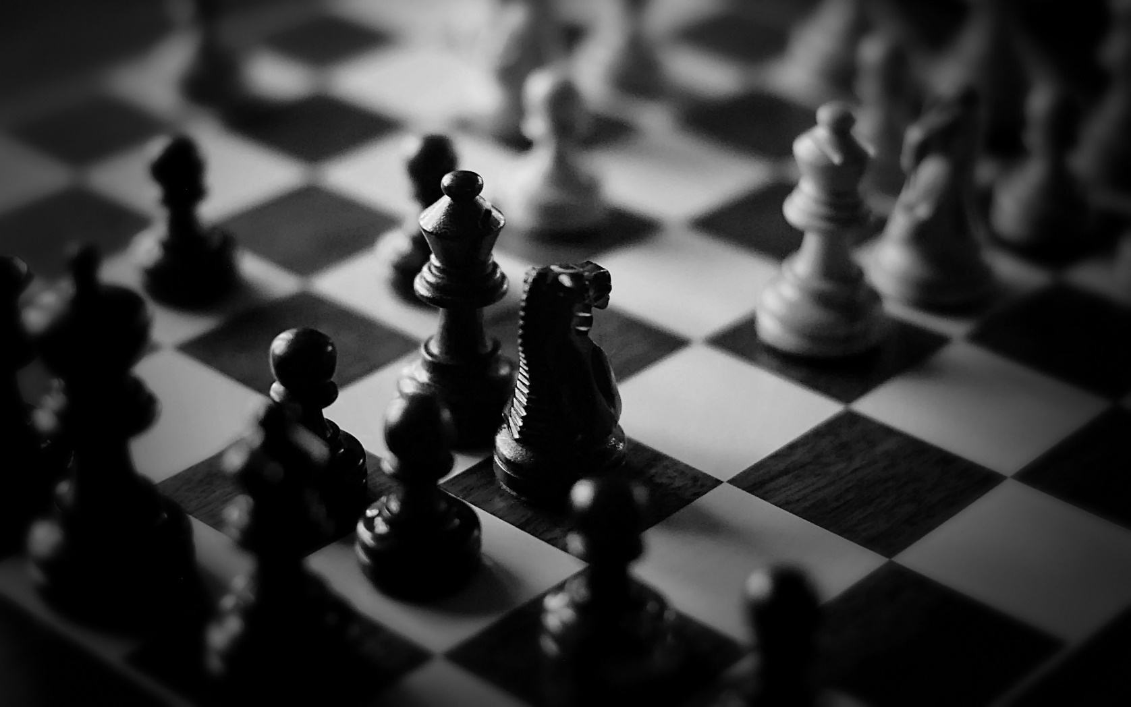
Agenda
Define the Chessboard
Initialize the Chessboard
Implement Chess Piece Representation
Move Validation
Player Turns
Display the Chessboard
Handle Special Rules
Game Loop
Win Loss Condition
End The Game

Slide 3

Synopsis
This code is an implementation of a simple command-line chess game in C. It allows two players to take turns making moves on an 8x8 chessboard. The code defines various chess pieces (pawn, rook, horse, camel, king, and queen) and provides functionality for player turns, piece movements, and checking for valid moves.

Slide 4
Technical Aspects
Programming Language: C
Data Structure: 2D Arrays

Slide 5
Include Statements
The code includes standard C libraries for various purposes:
<stdio.h> for standard input/output functions.
<stdlib.h> for general utilities.
<conio.h> for console I/O functions, which are platform-specific and not part of the standard C library.

Slide 6
Global Variable
Pwstatus and Pbstatus :
Arrays that keep track of the number of moves made by white and black pawns, respectively.
board: A 2D array representing the chessboard and its initial configuration.

Slide 7
Main Function
The main function is the entry point of the program. It controls the game flow.
It initializes variables and displays a welcome message. A game loop runs until the user presses the Enter key (ASCII value 13).
Within the loop, the code displays the current board, alternates between player 1 and player 2, and waits for the Enter key to continue

Slide 8
Display Function
The code declares several functions to handle different aspects of the chess game.
These functions include displaying the board, handling piece movement, and checking available moves for each type of chess piece

Slide 9
Change Function
The code declares several functions to handle different aspects of the chess game.
These functions include displaying the board, handling piece movement, and checking available moves for each type of chess piece

Slide 10
Piece Movement Functions
The code declares several functions to handle different aspects of the chess game.
These functions include displaying the board, handling piece movement, and checking available moves for each type of chess piece

Slide 11
Player1 and Player2 Functions
These functions handle the turn-taking and move execution for players 1 and 2, respectively.
Players input the position of the piece they want to move and the position where they want to place it.
These functions use piece movement functions to display available moves and update the board based on the player's input.

Slide 12
Check Functions
These functions are used to check whether a specific square on the board contains an opponent's piece, allowing for capturing.
Check is used for checking player 1's (white) pieces, and check2 is used for checking player 2's (black) pieces.

